Slide 1
Housing Sales Prices & Venues Data Analysis of Almaty
Alexey Startsev

Slide 2
1. A description of the problem and a discussion of the background.
Almaty is the largest city in Kazakhstan, with a population of about 2.000.000 people (about 11% of the country's total population) and it has a population density of 2.636 people per square kilometer. As a resident of this city, I decided to use Almaty in my project. The city is divided into 8 districts in total. Almaty generates approximately 20 per cent of Kazakhstan's GDP. The nation is the most powerful economically in Central Asia and Almaty is a key financial center. The economy of Almaty city and Almaty Region continues to grow and is expected to increase by nearly 6.5 percent per year. As you can see from the figures, Almaty is a city with a high population density, and it has a big investment potential.
From the investors point of view, we expect from them to prefer the districts where there is a lower real estate cost, high population density and the type of business they want to install is less intense. And from the city resident point of view, it's mostly valuable to chose districts where real estate values are lower, and the social places density is high.
However, it is difficult to obtain information that will guide investors in this direction, nowadays. When we consider all these problems, we can create a map and information chart where the real estate index is placed on Almaty and each district is clustered according to the venue density.

Slide 3
2. A description of the data and how it will be used to solve the problem.
To solve the problem I will use below data:
I found the population of Almaty districts data from https://journals.openedition.org/belgeo/28865?lang=en, cleaned it and uploaded to Github repository
I used Forsquare API to get the most common venues of given Borough of Almaty.
There are not too many public datas related to demographic and social parameters for the city of Almaty. Therefor you must set-up your own data tables in most cases. In this case, I collected latest per square meter Housing Sales Price (HSP) Averages for each Borough of Almaty from housing retail web page (https://krisha.kz/content/analytics).
I used Google Map, ‘Search Nearby’ option to get the center coordinates of each Borough.

Slide 4
3. Methodology section
As a database, I used GitHub repository in my study. My master data which has the main components Borough, Average House square meter Price, Latitude and Longitude informations of the city.
I used python folium library to visualize geographic details of Almaty and its boroughs and I created a map of Istanbul with boroughs superimposed on top. I used latitude and longitude values to get the visual as below:

Slide 5
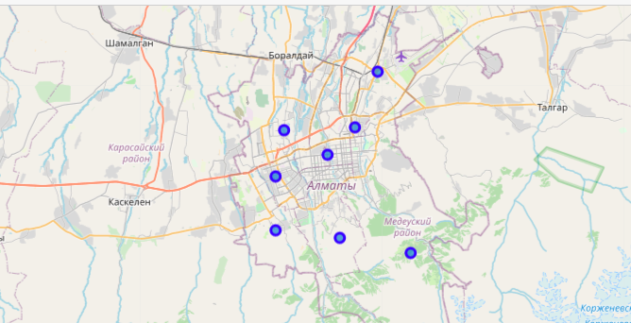

Slide 6
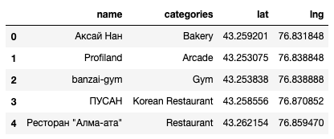
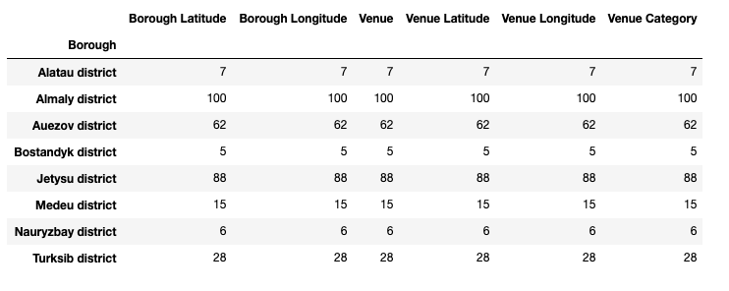
I utilized the Foursquare API to explore the boroughs and segment them

Slide 7
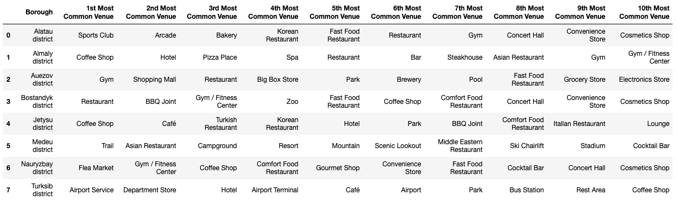
I created a table which shows list of top 10 venue category for each borough

Slide 8
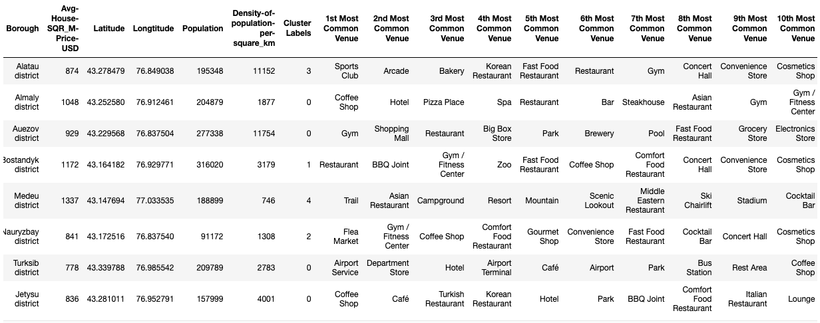
I will run K-Means to cluster the boroughs into 5 clusters

Slide 9
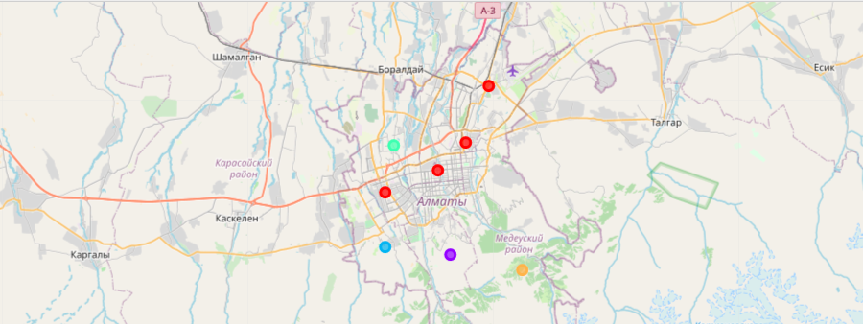
4. Results section
You can see a clustered map boroughs of Almaty

Slide 10
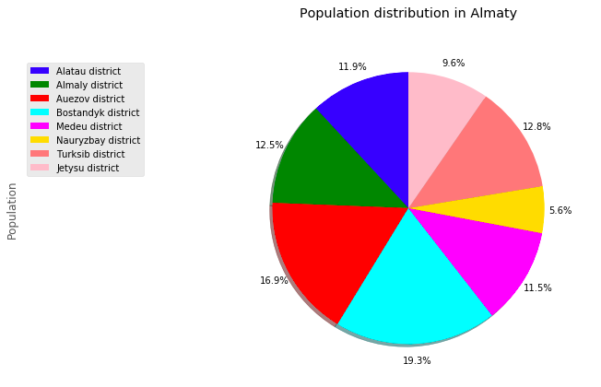
Population distribution in Almaty

Slide 11
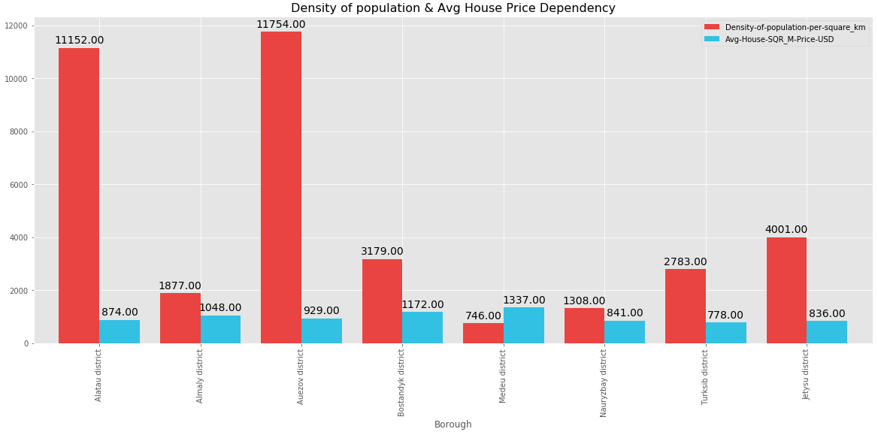
Avg House Price and Population Density Dependancy

Slide 12
5. Discussion section
As I mentioned before, Almaty is a big city with a high population density in a narrow area. The total number of measurements and population densities of the 8 districts in total can vary. As there is such a complexity, very different approaches can be tried in clustering and classification studies.
I used the Kmeans algorithm as part of this clustering study. For more detailed and accurate guidance, the data set can be expanded, and the details of the neighborhood or street can also be drilled.
I also performed data analysis through this information by adding the coordinates of districts and home sales price averages as static data on GitHub.
I ended the study by visualizing the data and clustering information on the Almaty map. It could be used by city government and investors.

Slide 13
6. Conclusion section
As a result, people are turning to big cities to start a business or work. For this reason, people can achieve better outcomes through their access to the platforms where such information is provided.
Not only for investors but also city managers can manage the city more regularly by using similar data analysis types or platforms.

Slide 14
7. References section
https://en.wikipedia.org/wiki/Almaty
https://journals.openedition.org/belgeo/28865?lang=en
https://developer.foursquare.com/
https://krisha.kz/content/analytics
https://www.google.com/maps/place/Almaty/@43.2178605,76.6639808,10z/data=!3m1!4b1!4m5!3m4!1s0x38836e7d16c5cbab:0x3d44668fad986d76!8m2!3d43.2220146!4d76.8512485
https://www.linkedin.com/pulse/housing-sales-prices-venues-data-analysis-ofistanbul-sercan-y%C4%B1ld%C4%B1z/

